Slide 1


Single Path Routing & Network Optimization Subject to Max-Min Fair Flow Allocation
By:
Rohit Jakka (N18143604)
Shreyaansh Srivastava (N14688224)
Ronald Christopher (N18279023)

Slide 2
Outline
Goals
Network routing subject to max-min fair flow allocation
Max-min fair (MMF) resource allocation
Previous work on network optimization with MMF flow allocation
Network routing subject to MMF flow allocation
MILP formulation
Generation algorithm
Results
Summary

Slide 3
Traffic Engineering Goals
Goals:
Maximum flow or bandwidth allocation
Minimum end to end delay.
Route assignment
Traffic control
Service quality differentiation
Balanced or fair bandwidth allocation between different aggregates of flows

Slide 4
Max Min Fairness
Fairness:
Each consumer gets as much resources as any other
Max Min Fairness:
Maximize the share of the consumer with the minimum allocation
Allow others to get more
Repeat this argument repeatedly, namely
The consumers that can increase their resource portion without hurting other’s will increase it again as any other that can.

Slide 5
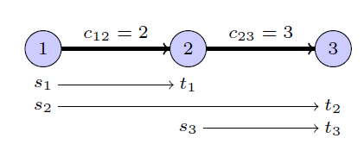
Max-min fair (MMF) resource allocation
Max-min fairness is widely used in a number of areas, including networks
Informally: a resource allocation is MMF if not only the smallest amount allocated is maximized but also the second smallest, the third smallest,...
Network flows:
Given graph with arc capacities, m origin-destination pairs {(s_{k}, t_{k})}_{1≤k≤m}, and predefined routing paths, allocate the flow

Slide 6
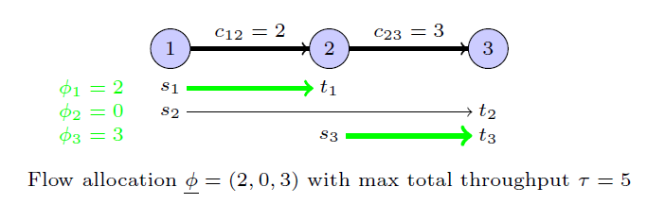
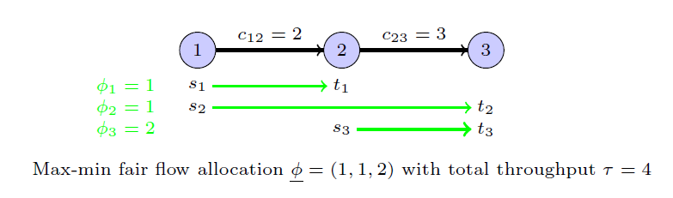
And for

Slide 7
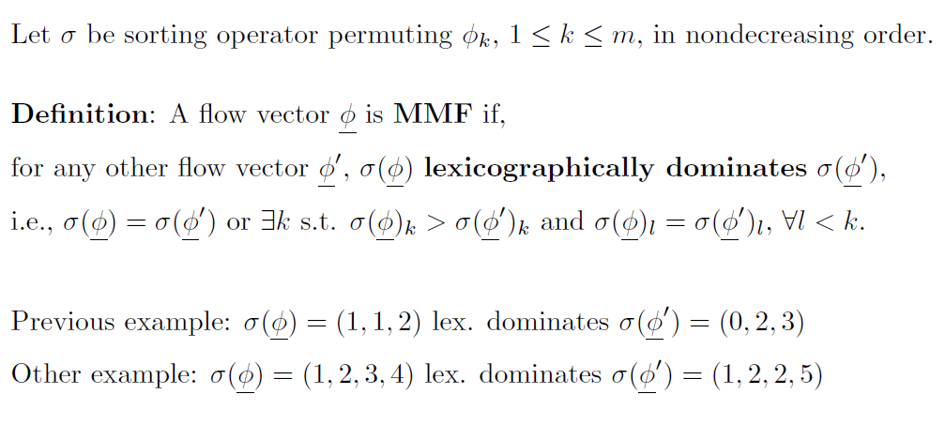
MMF network flow allocation
Equivalently: there is no way to increase the flow of any user without decreasing the flow of a user with a smaller or equal flow.

Slide 8
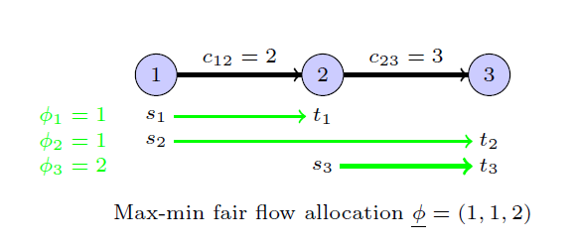

Previous work on MMF network optimization
When routing paths are given, polynomial-time ”progressive filling” algorithm yields a MMF flow
Start from simultaneously increase all the flows until one or more arcs are saturated.
Remove such bottleneck arcs and all saturating (s, t) pairs, compute the residual capacities, and keep on increasing the remaining flows.

Slide 9
Previous work on MMF network optimization
When routing paths are given, polynomial-time ”progressive filling” algorithm yields a MMF flow
When routing paths are not known a priori, algorithms to find splittable or unsplittable MMF flow
Single-source variant where paths are selected to maximize fairness:
polynomial-time algorithm for fractional flow
NP-hardness and approximation algorithms for single path routing
So far max-min fairness has been considered as a routing objective

Slide 10
Network routing subject to MMF allocation
Motivation: IP (Internet Protocol) networks
MMF is a reference model for fair capacity allocation when traffic flows are elastic and can adapt their rate based on resource availability.
Due to transport protocols (TCP), the distributed congestion control mechanism leads to an average bandwidth allocation which is well approximated by MMF over the routing paths provided by the IP layer.
In best-effort service the network is expected to provide the best possible service in terms of rate without privileging any traffic flow.

Slide 11
Network routing subject to MMF allocation Cont.
The network operator aims at optimizing routing based on a classical traffic engineering objective (e.g., throughput), while assuming a MMF bandwidth/flow allocation, which cannot be directly controlled.
This network routing problem can be viewed as a bilevel optimization problem:
at the upper level, the network operator selects the routing paths for the origin-destination pairs so as to maximize its utility function,
at the lower level, the transport protocol allocates the bandwidth/flow to the selected paths according to the MMF paradigm.

Slide 12
Network routing subject to MMF allocation cont.
MMF-constrained Single Path Routing problem:
Given
a directed graph G = (V,A) with a capacity c_{ij} ≥ 0 for each arc (i, j) ∈ A,
a set of origin-destination pairs (s_{k}, t_{k}), with s_{k}, t_{k} ∈ V and 1 ≤ k ≤ m,
select one routing path for each (s_{k}, t_{k}) pair so as to
maximize a network utility function (total throughput),
while assuming an MMF flow allocation.
Proposition: NP-hard even when c_{ij} = 1 for all (i, j) ∈ A
By reduction from the existence of edge-disjoint paths

Slide 13
Network routing subject to MMF allocation
Proposition:
The gap (throughput or smallest flow allocation) between optimal solutions of MMF- constrained and MMF objective SPR can be arbitrarily large.
t2
t3
t1
t4
t5
10
b2
b3
b1
b4
b5
1
1
10
1
1
a2
a3
a1
a4
a5
10
S2
S3
S1
S4
S5
Capacity of dashed arcs ≥ 5

Slide 14

Cont.
t2
t3
t1
t4
t5
10
b2
b3
b1
b4
b5
1
1
10
1
1
a2
a3
a1
a4
a5
10
S2
S3
S1
S4
S5
1
1
10
1
1

Slide 15

Cont.
t2
t3
t1
t4
t5
10
Capacity of dashed arcs ≥ 5
b2
b3
b1
b4
b5
1
1
10
1
1
a2
a3
a1
a4
a5
10
S2
S3
S1
S4
S5
2
2
2
2
2

Slide 16
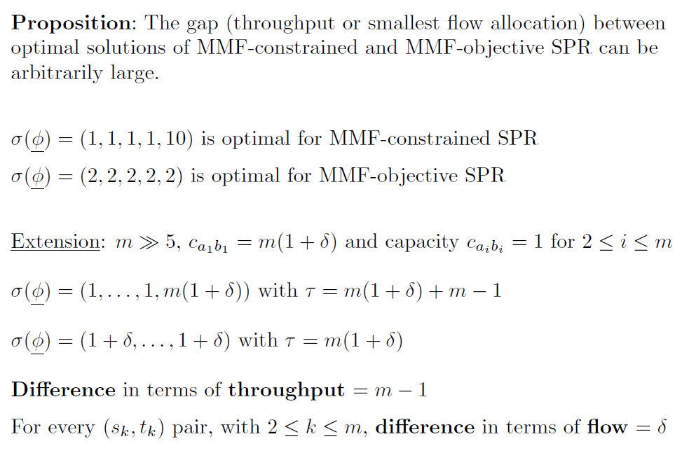
Network routing subject to MMF allocation

Slide 17
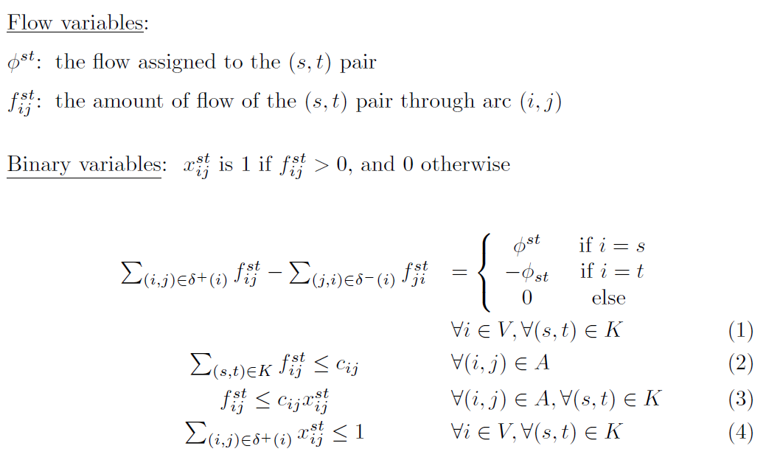
Single-level MILP formulation

Slide 18
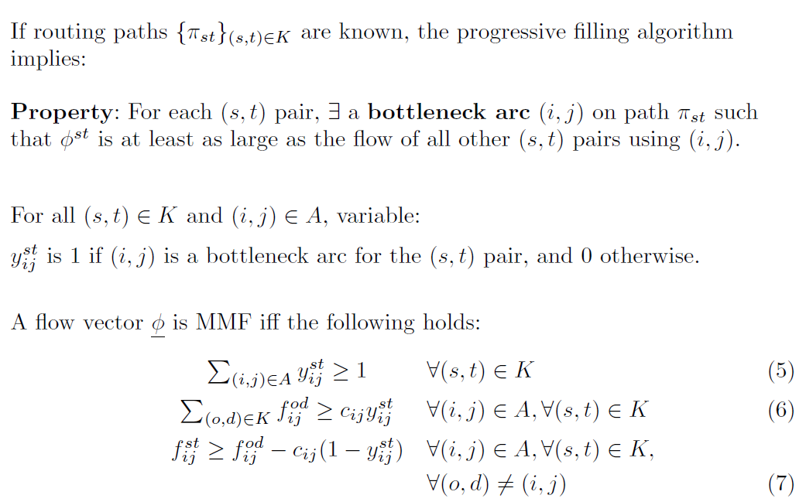
MMF flow-allocation constraints

Slide 19
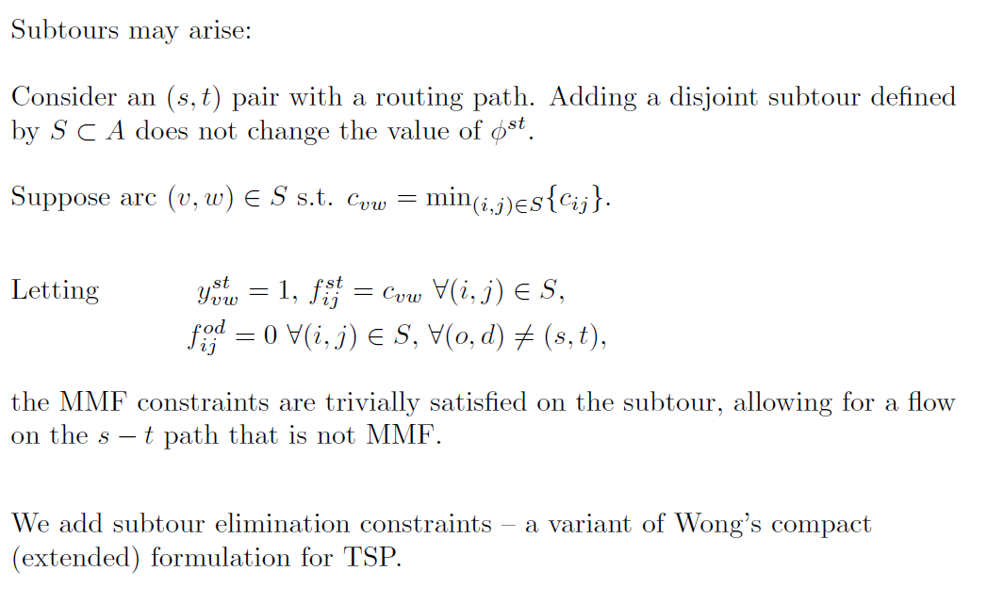
Elimination constraints

Slide 20
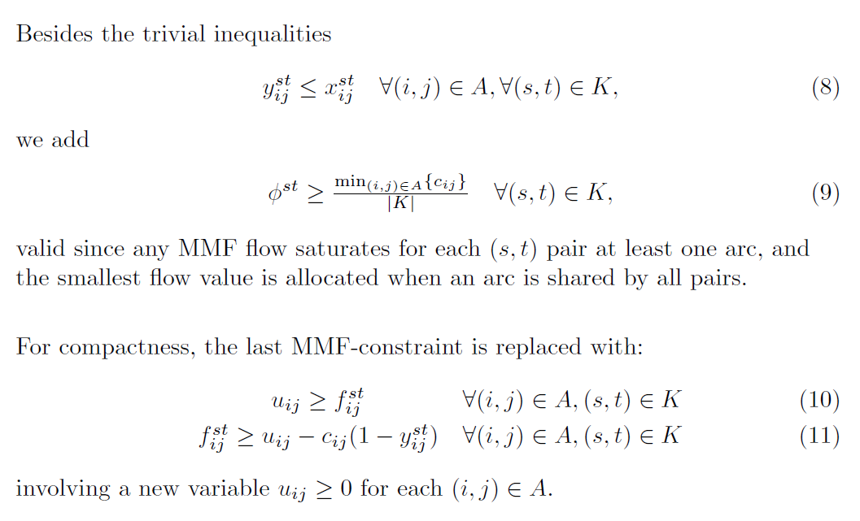
Other valid inequalities

Slide 21
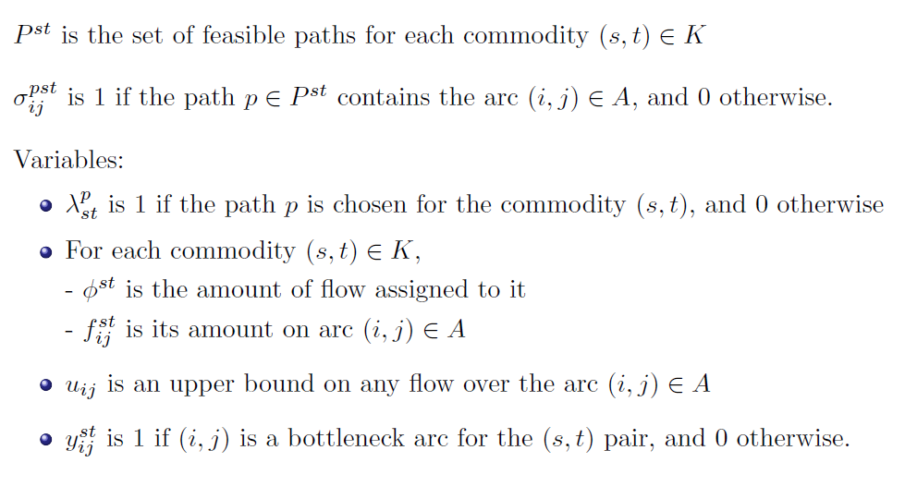
Generation Column algorithm
Path formulation:

Slide 22
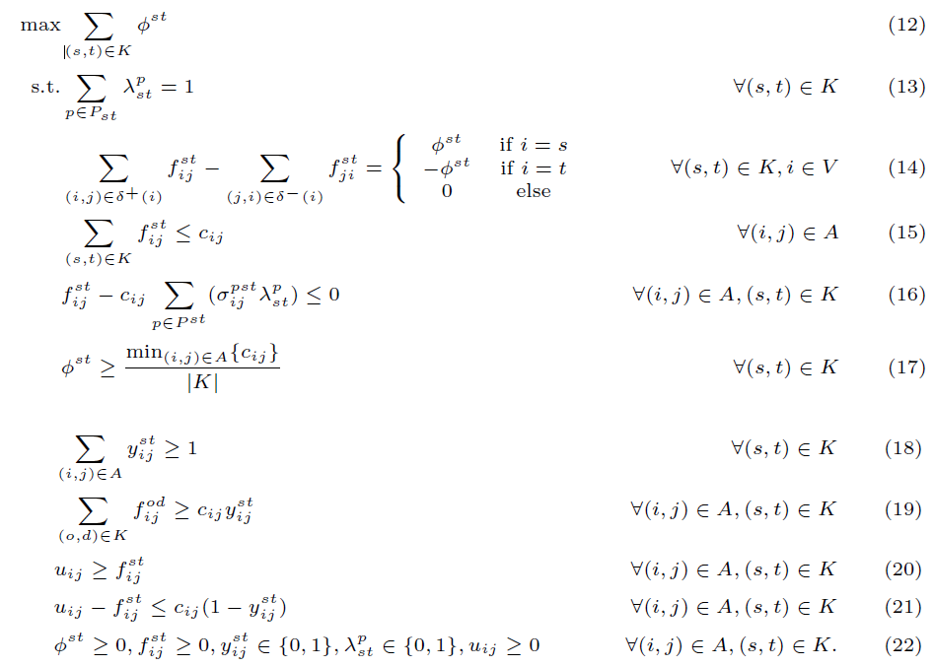

Slide 23
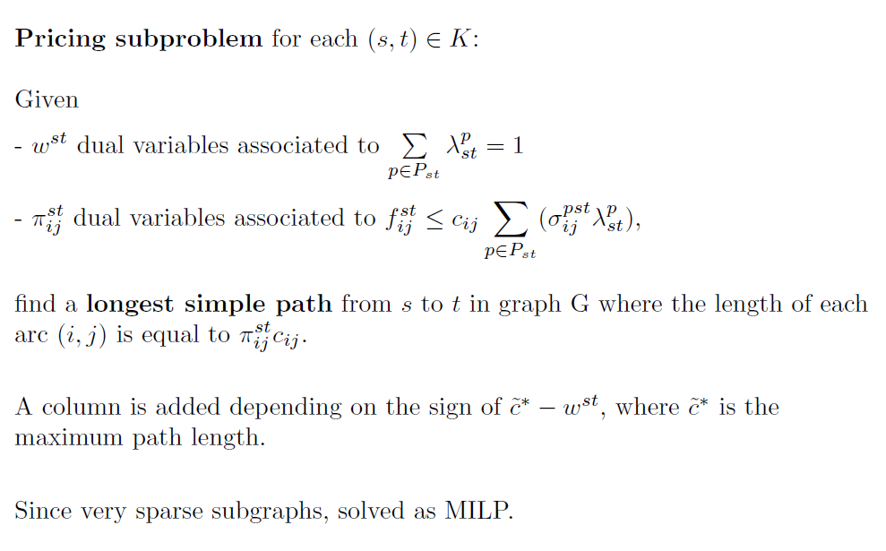

Slide 24
Computational Results
Topologies from SND library:
nobel-us (|V| = 14, |A| = 21), polska (|V| = 12, |A| = 18)
atlanta (|V| = 15, |A| = 22), Abilene (|V| = 12, |A| = 15)
also randomly generated (s, t) pairs
Since capacities are not provided for SND library instances, we assume, for simplicity, that every link has the same capacity of 1000 Mbps

Slide 25
Computational Results
Column generation:
The computational experiments are carried out on a machine equipped with 4 Intel i5 processors and 16GB of RAM. For simplicity, we assume that all the communications have the same weight wst = 1. In the objective function (2), we let α= 1000 and β= 200
Time limit = 1hour
Our MILP formulations are solved with CPLEX using the AMPL modeling language.

Slide 26
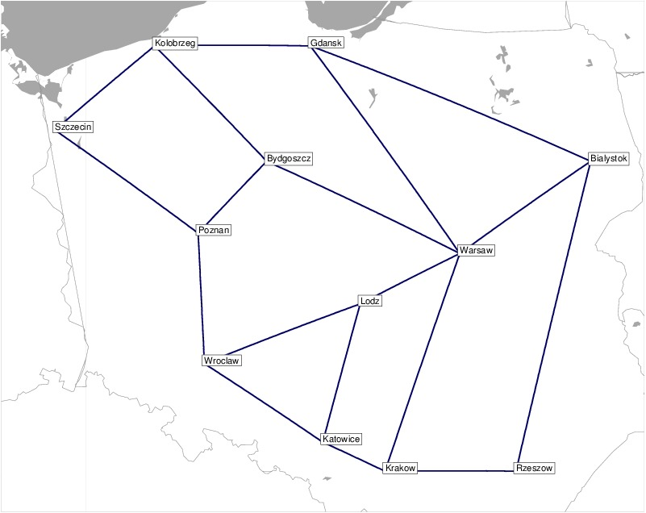
Polska Topology

Slide 27
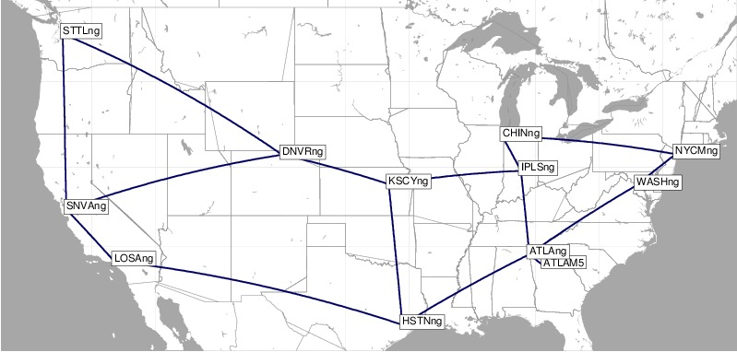
Abilene Topology

Slide 28
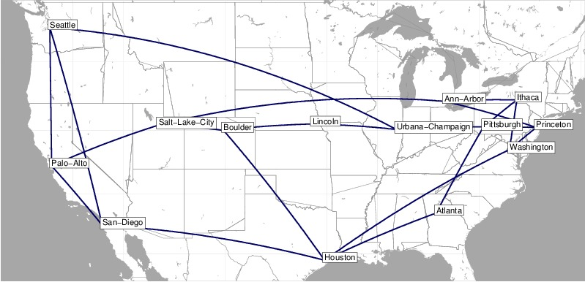
Nobel-us Topology

Slide 29
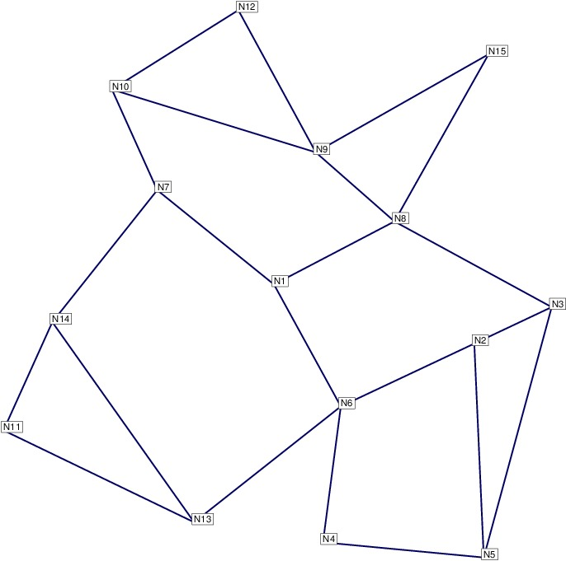
Atlanta Topology

Slide 30
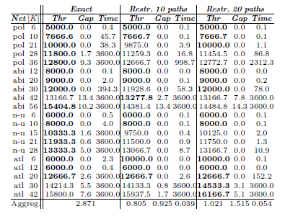
Results with the exact and the restricted paths formulations with objective function

Slide 31
Summary
We have proposed a traffic engineering problem where, given a network topology with link capacities and a set of communications, we must select a single path for each communication so as to maximize a network utility function, assuming a MMF bandwidth allocation. We have shown that this problem can be cast as a single mixed-integer linear program with a polynomial number of variables and constraints, which is solvable in a reasonable amount of computing time for medium-size networks.
New class of network routing problem where the paths are selected to optimize a network utilization measure subject to MMF ﬂow allocation.
The column generation approach yields promising results.

Slide 32
Thank you!!

